Slide 1
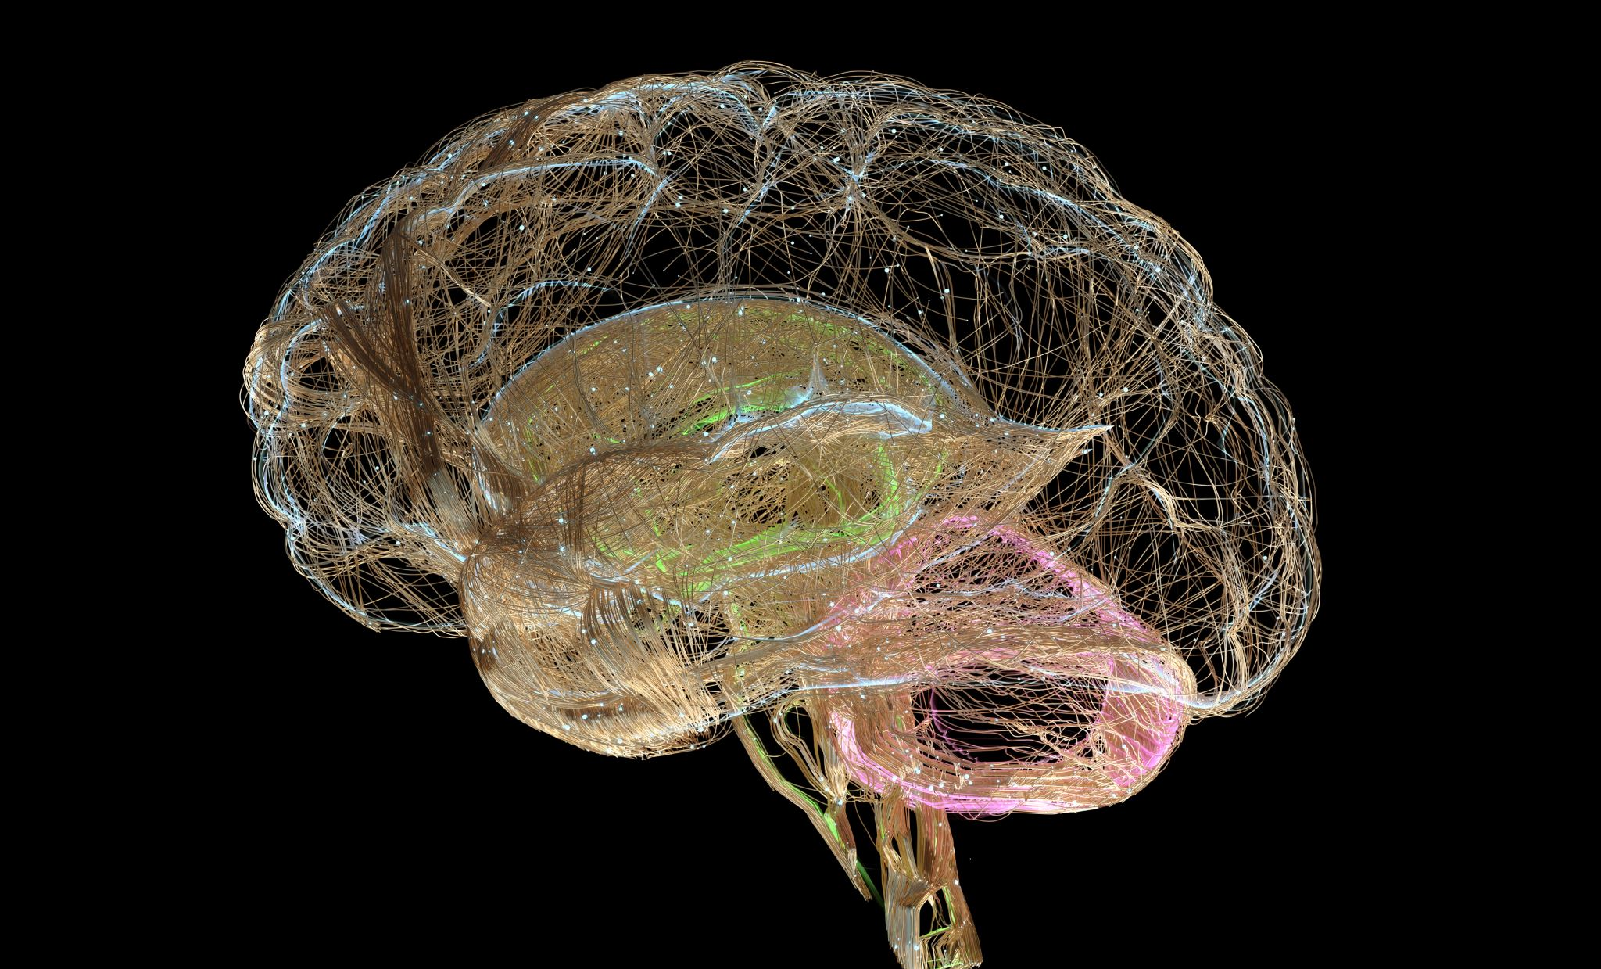
MENTAL HEALTH
EMOTIONAL
PSYCHOLOGICAL
SOCIAL WELL BEING

Slide 2
WHAT IS MENTAL HEALTH
Mental health includes our emotional,psychological and social well being.
It affects how we think ,feel,and act
It also helps determine how we handle stress,relate to others,and make healty choices.
Mental health is important at every stage of life from childhood and adolescence through adulthood.

Slide 3
WHY MEANTAL HEALTH IS IMPORTANT
Mental and physical health are equally important components of overall health.
Depression increases the risk for many types of physical health problems

Slide 4
WHAT CAUSES MENTAL ILLNESS
Adverse childhood experiences, such as trauma or history of abuse
Experiences related to other ongoing medical conditions ,such as cancer or diabetes
Having feelings of loneliness or isolation

Slide 6
THANK YOU

